Slide 1

ATMs

Slide 2
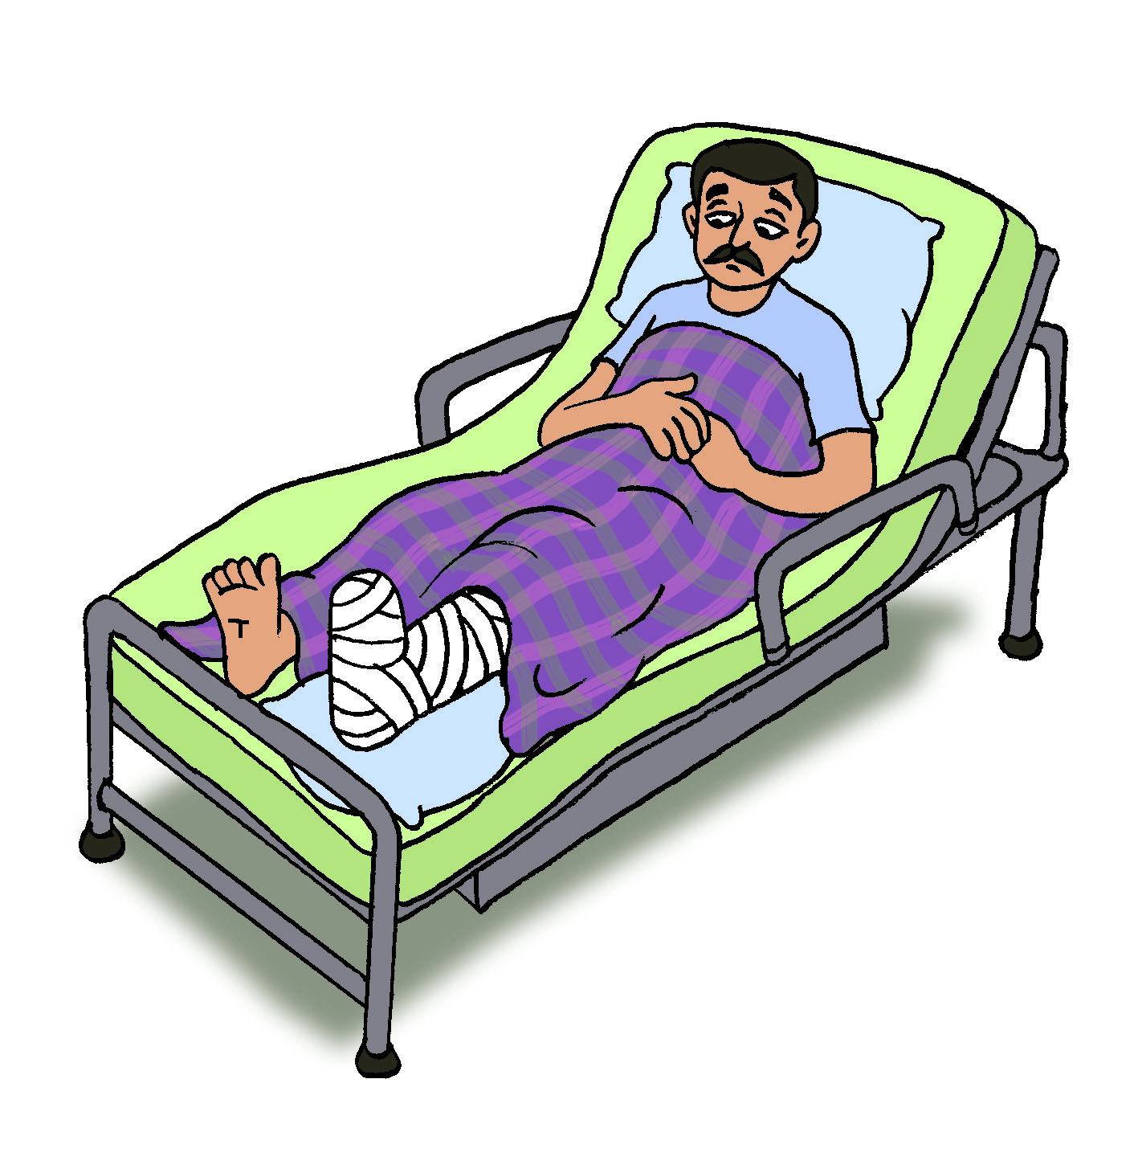

Why were ATMs invented?
ATMs were invented to avoid situations like these.
Banks deposit cash into ATMs so that it can be withdrawn when banks close and on holidays
It is 11:30 pm! My brother has had an accident and the hospital has asked me to pay Rs.25,000. How will I get money at this time?

Slide 3

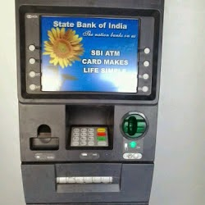

What services are provided by ATMs?
Cash Withdrawal
Mini Statement
Cheque Deposit
Cash Deposit
Vending Coins
New pin generation

Slide 4
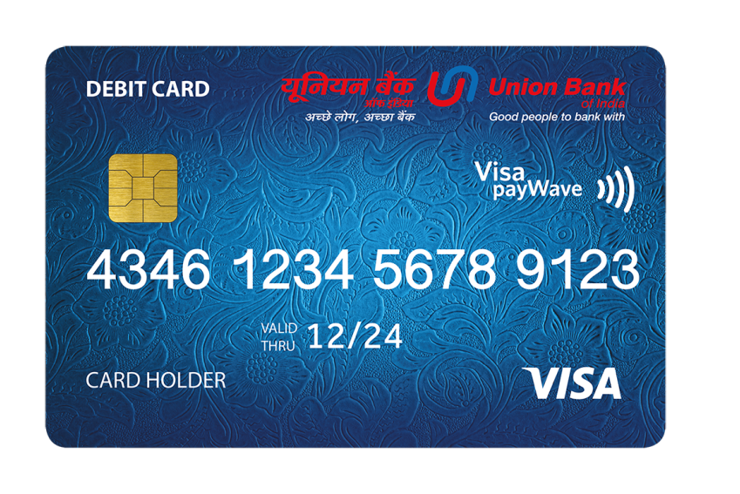
How does one transact at an ATM?
You need a Debit or Credit card to transact at an ATM
User inserts card in the ATM
User inputs pin
ATM dispenses cash (if enough)
Money is debited from account

Slide 5


What is the PIN?
The PIN is a secret 4 digit code that is given to the customer
NEVER
Write down your PIN!
Tell your PIN to anyone!

Slide 6

What do I do if…?
I’ve lost my Debit card?
I’ve forgotten my PIN
Call the call centre or visit the bank to make the card non operational
Ask the bank to send a new card
Regenerate your PIN by:
Visiting the bank
Internet banking
Phone banking

